Slide 1



2015 New Participants Training for International Trade Administration (ITA) – Market Development Cooperator Program (MDCP)
Post Award Activity, Monitoring and ASAP Payments
Presented by: Janet Johnson Russell
September 10, 2015

Slide 2
Grants Management Division Contacts for ITA
Arlene Simpson Porter – Director, Grants Management Division
Arlene.S.Porter@noaa.gov, 301-628-1314
Debbie Chen – Branch Chief for ITA Grants Programs
Debbie.Chen@noaa.gov, 301-628-1313
Janet Johnson Russell – Grants Officer for ITA Grants Programs
Janet.J.Russell@noaa.gov , 301-628-1318
Lamar Revis – Grants Officer for ITA Grants Programs
(Effective 10/01/2015 )
lamar.revis@noaa.gov, 301-628-1308

Slide 3
Contents
  Grants Management Updates
    2 CFR Part 200
  Post Award Actions
  Monitoring
    Award Specific Special Award Conditions
    Reporting requirements
    - Federal Financial Reports - SF425 (FFR)
    - Performance Progress Reports (PPR)
  ASAP – Enrollment and Payments.

Slide 4


Grants Management Updates
2 CFR Part 200: Uniform Guidance
A-21
Cost Principles for Educational Institutions
Implemented December 26, 2014
Supersedes and Streamlines Policies into
Applies to:
  New awards on or after 12/26/2014
  Funding increments on or after 12/26/2014
A-87
Cost Principles for State, Local and Indian Tribal Governments
A-110
Uniform Administrative Requirements for IHEs, Hospitals, and Non-Profits
2 CFR 200
A-122
Cost Principles for Non-Profit Organizations
A-133
Audits of States, Local Governments, and Non-Profit Organizations
A-50
Audit Follow up
A-89
CFDA
A-102
Grants and Cooperative Agreements With State and Local Governments

Slide 5
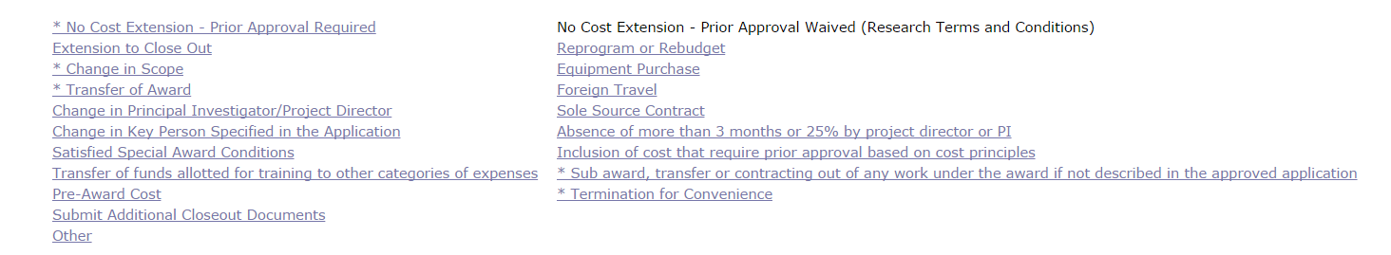
Post Award Actions

Slide 6
Post Award Activity
Post Award Requirements are pursuant to 2 CFR Part 200 Subpart D.
When submitting a post award request in Grants Online the recipient must:
  Submit appropriate documentation for designated request in accordance with established timelines.
  Ensure that all reports (financial and progress) have been submitted!
  Adhere to all administrative terms and conditions when related to post award activity such as:
      When a request should be submitted; and
      Who should submit the request
  Make sure that all amendments have been accepted by the recipient authorized representative
  Obtain concurrence from the Federal Program Office

Slide 7
Frequently Submitted Award Action Requests
Post Award Activity
No Cost Extension
  The request to extend the award period should be submitted to the FPO at least 30 days prior to the expiration of the award.
    A written request may be submitted to the Program Officer clearly justifying why the extension is needed and explain what activities are remaining to be accomplished under the award and what funds are still available to support the activity.

Slide 8
Frequently Submitted Award Action Requests
Post Award Activity
Extension to Close Out
  Recipients have 90 days after the award expires to submit all reports by the terms and conditions of the award and liquidate all obligations incurred.
    An extension to the closeout period should only be requested to complete the preparation of final reports and make final payments.
Reprogram or Re-budget
  Request for prior approval of any budget revisions that transfer funds among line item cost categories shall be submitted on the SF-424A.
  Request to change and/or add program objectives may or may not constitute a budget revision, however a detailed explanation of the reprogramming request is required.

Slide 9
Frequently Submitted Award Action Requests
Post Award Activity
Change in Scope
  Change in the methodology, approach or other aspects of the project object must receive prior approval from NOAA.
    A detailed justification must be provided by the grantee and attached to the file.
Equipment Purchase
  If purchasing equipment in excess of $5,000, recipient must determine a Lease vs. Purchase and provide a justification explaining the determination , as well as the purpose for which the equipment is to be used. – 2 CFR §200.33

Slide 10
Cost-share and Match
Usually referred to as “Non-Federal Share” or Recipient Share” in the award documents
  May be required by statute or regulation and thereby non-negotiable
  Can be required by Program and may be negotiable
  Voluntarily cost-share/match incorporated into an award must be accounted for as the non-Federal share of the total project costs approved.
References
  2 CFR § 200.306
  DOC Standard Terms and Conditions A.03

Slide 11
Cost-share and Match …
Federal to non-Federal ratio as stated in the award must be met
If total costs are less, then the ratio as stated will apply to all costs
If total costs are greater, then the Federal amount remains the same as awarded; and
Non-Federal share must be expended at a rate proportional to the Federal share unless:
  It was part of the original application approved under the award.

Slide 12
Cost-share and Match …
Here is an example of a two to one match
Award is approved for $299,531 Federal and $599,062 non-Federal for a total of $898,593 (match ratio of 67%)
If for any reason, the non-federal share is not met, then the difference of the federal approved match (percentage) will have to be return to NIST Finance Office.

Slide 13
Indirect Cost Rate Deviations
Provide a de minimis indirect cost rate of 10% of MTDC to those non-Federal entities who have never had a negotiated indirect cost rate, thereby eliminating a potential administrative barrier to receiving and effectively implementing Federal financial assistance;
Require Federal agencies to accept negotiated indirect cost rates unless an exception is required by statute or regulation, or approved by a Federal awarding agency head or delegate based on publicly documented justification;
Allow for a one-time extension without further negotiation of a federally approved negotiated indirect cost rate for a period of up to 4 years.

Slide 14

Monitoring

Slide 15
Monitoring
Monitoring ensures that the terms and conditions of the award are fulfilled. Award monitoring is the responsibility of the grantee, Grants Office and Program Office.
  Performance Progress reports (PPR) are coordinated with the Program Office
    Schedule of report submission is identified in the award as a term and
    condition
  Federal Financial reports (FFR) are coordinated with the Grants Office
Reporting Requirements – The SF-425 Federal Reports are due quarterly and the final SF-425 Full report is required within 90 days of the project
end date.
Agency Review is reviewed by the Grants Management Specialist (GMS) – Prior to ASAP payment request being approved by the GMS. All reports both PPR and FFR SF-425 must be submitted/accepted via grants online by the due dates. Also, the non-federal share match of 2:1 must be met.

Slide 16
Federal Financial Report
SF425

Slide 17
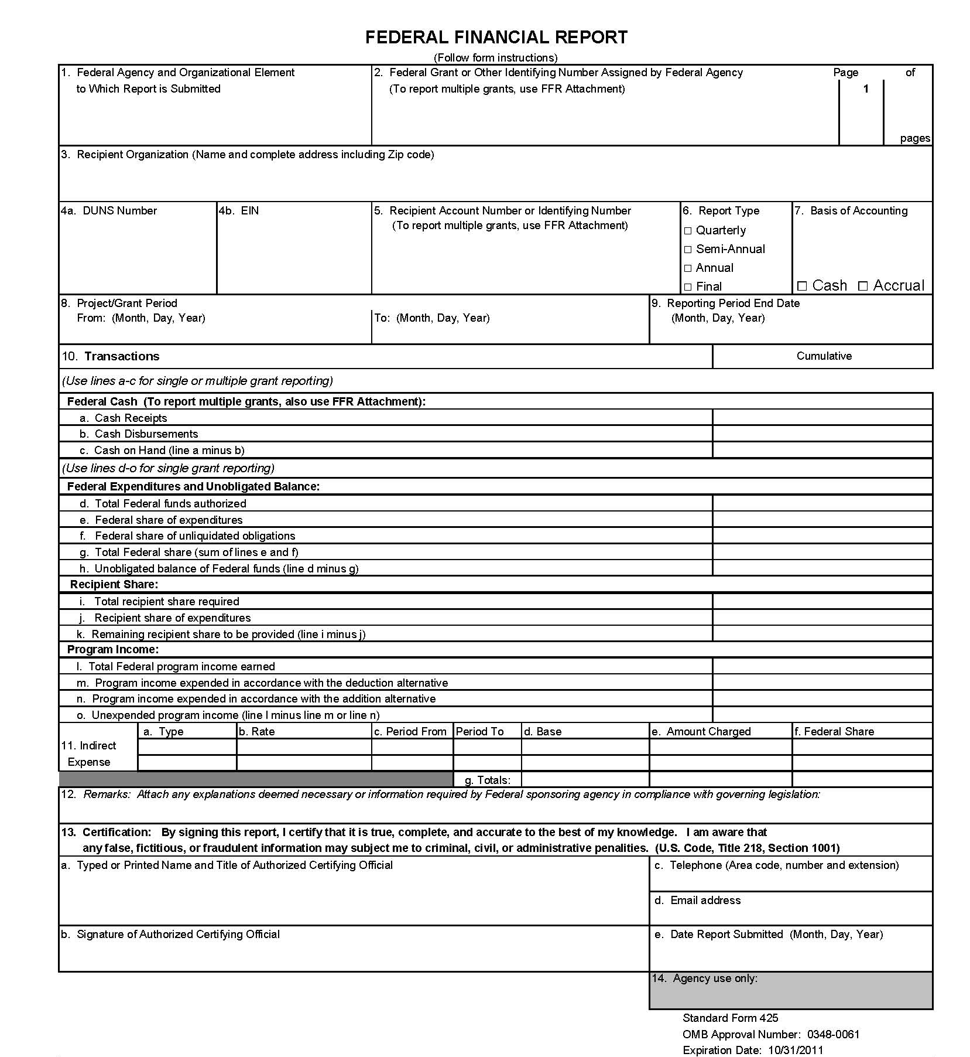

Slide 18
GENERAL INFORMATION
FEDERAL AGENCY AND ORGANIZATIONAL ELEMENT TO WHICH REPORT IS SUBMITTED
FEDERAL GRANT OR OTHER IDENTIFYING NUMBER ASSIGNED BY THE FEDERAL AGENCY
RECIPIENT ORGANIZATION – NAME AND COMPLETE ADDRESS INCLUDING ZIP CODE
4a. DUNS NUMBER
4b. EIN

Slide 19
GENERAL INFORMATION CONTINUED
5. RECIPIENT ACCOUNT NUMBER OR IDENTIFYING NUMBER
6. REPORT TYPE – Quarterly; Semi-Annual; Annual; Final
BASIS OF ACCOUNTING – Cash or Accrual
(Cash basis refers to accounting method in which expenses are recorded when they are paid. For Accrual basis, expenses are recorded when incurred.)
8. PROJECT/GRANT PERIOD (FROM DATE AND TO
DATE)
9. REPORTING PERIOD END DATE

Slide 20
Federal Financial Report
10 a. CASH RECEIPTS – Enter the cumulative amount of actual cash
received from the federal government since the inception of
the award as of the reporting period end date.
10 b. CASH DISBURSEMENTS – Enter the cumulative amount of
federal fund disbursements since the inception of the award
as of the reporting period end date.
10 c. CASH ON HAND – Cash Receipts less Cash Disbursements
equals Cash on Hand (10a – 10b = 10c). This represents
immediate cash needs. If the amount is greater than $5,000,
an explanation is required in block 12.

Slide 21
FEDERAL EXPENDITURES & UNOBLIGATED BALANCE PORTION
10 d. TOTAL FEDERAL FUNDS AUTHORIZED – Enter Federal Share of
Cost (CD450 or CD451).
10 e. FEDERAL SHARE OF EXPENDITURES – Enter the amount of Federal
fund expenditures. Always same as 10b. (cash disbursed)
10 f. FEDERAL SHARE OF UNLIQUIDATED OBLIGATIONS – Unliquidated
obligations (UO) on a cash basis are obligations incurred, but not yet
paid. UO on an accrual basis are obligations incurred, but for which an
expenditure has not yet been recorded.

Slide 22
FEDERAL EXPENDITURES & UNOBLIGATED BALANCE PORTION CONT.
10 g. TOTAL FEDERAL SHARE – Enter Federal Share of Expenditures
plus Federal Share of Unliquidated obligations equals the Total
Federal Share (10e + 10f = 10g).
10 h. UNOBLIGATED BALANCE OF FEDERAL FUNDS – Enter Total
Federal Funds Authorized less Total Federal Share equals
Unobligated Balance of Federal Funds (10d – 10g = 10h).

Slide 23
RECIPIENT SHARE PORTION
10 i. TOTAL RECIPIENT SHARE REQUIRED – Enter Recipient
Share of Cost (CD450 or CD451).
10 j. RECIPIENT SHARE OF EXPENDITURES – Enter the amount of Recipient
Share of actual cash disbursements or other outlays (e.g. Third party in-
kind contributions).
10 k. REMAINING RECIPIENT SHARE TO BE PROVIDED – Total Recipient Share
Required less Recipient Share of Expenditures (10i – 10j = 10k).

Slide 24
PROGRAM INCOME PORTION
Section 10 of the SF-425
What is Program Income? Program Income is income earned by a grant recipient from activities which are supported by the direct costs of an award. For example, fees received to attend a conference or workshop funded by a sponsored project.
10l. TOTAL FEDERAL PROGRAM INCOME EARNED – Enter the amount of
program income earned.
  10m. PROGRAM INCOME EXPENDED IN ACCORDANCE WITH THE DEDUCTION
  ALTERNATIVE – Amount of program income earned that was used to
  reduce the federal share of the total project cost.

Slide 25
PROGRAM INCOME PORTION CONTINUED
Section 10 of the SF-425
10 n. PROGRAM INCOME EXPENDED IN ACCORDANCE WITH THE ADDITION
ALTERNATIVE – amount of program income earned that was added to funds
committed to the total project.
10 o. UNUSUED PROGRAM INCOME – Program income that has been earned
but not expended, as of the reporting period end date. Total Federal
Program Income Earned less Program Income Expended in Accordance with
the Addition Alternative equals the Unused Program Income
(10l – 10n = 10o).

Slide 26
INDIRECT EXPENSE
What are Indirect Costs (F&A)?
Allowable costs that are incurred for common or joint objectives and therefore cannot be identified readily and specifically with one sponsored project or proportionally charged to multiple sponsored projects (e.g. office supplies).

Slide 27
INDIRECT EXPENSE
11 a. TYPE OF RATE – State whether indirect cost rate(s) is Provisional,
Predetermined, Final, or Fixed.
11 b. RATE – Enter the indirect cost rate in effect during the reporting period.
11 c. PERIOD FROM; PERIOD TO – Enter the beginning and ending effective
dates for the rate(s).
11 d. BASE – Enter the amount of the base against which the rate was applied
(Modified Total Direct Cost).
11 e. AMOUNT CHARGED – Enter the amount of indirect costs charged
during the time period specified. Rate times Base equals Amount
charged (11b x 11d= 11e).
11 f. FEDERAL SHARE – Enter Federal share of the amount in 11e.
11 g. TOTALS – Enter totals for columns 11d, 11e and 11f.

Slide 28
GENERAL INFORMATION
12. REMARKS (Clarifications or Justifications)
13. CERTIFICATION (This field is populated by GOL.)
a. Typed or Printed Name and Title of Authorized Certifying Official
b. Signature of Authorized Certifying Official
c. Telephone
d. Email Address
e. Date Report Submitted
14. AGENCY USE ONLY

Slide 29
General Information…
Once the recipient completes the report in GOL, he/she will save it, and then submit it to the agency.
Finally, the Grants Management Specialist will receive the report in their GOL task box for review and approval.

Slide 30
Automated Standard Application For Payment (ASAP)

Slide 31
Payment Methods
ASAP (Automated Standard Application for Payment)
www.asap.gov

Slide 32
Enrollment Process
For ITA Awards the following information must be provided to
the Enrollment Initiator to begin the process:
EIN/TIN # [Tax Identification Number, Social Security]
DUNS # [Data Universal Numbering System (Dun & Bradstreet)}
Name of Organization
Type of Organization (Non-profit, State, University, ect)
Address
Point of Contact
Point of Contact’s Title
Point of Contact’s Email Address
Point of Contact’s Phone Number
After the data is entered into ASAP by the Enrollment Initiator , the Point of Contact at the Recipient Organization will receive a user-id via e-mail and a password will be sent via the Post Office by Treasury.

Slide 33
Enrollment Process
Enrollment Initiator
Point of Contact
Head of Organization
Authorizing Official
Financial Official
The ASAP enrollment process is initiated by the Enrollment Initiator (Grants Management Specialist) after the Grants Officer signs the award. No additional information is needed from the recipient.

Slide 34
Enrollment Process
Enrollment Initiator
Point of Contact
Head of Organization
Authorizing Official
Financial Official
After receiving their ASAP user-id and password, the Organization’s Point of Contact logs in and verifies the DUNS, TIN, and official organization name entered by the Enrollment Initiator. Then they enter their Head of Organization, Authorizing Official, and Financial Official into the ASAP system.

Slide 35
Enrollment Process
The following systems MUST ALL AGREE in order for the grant process to run smoothly.
Grants on Line
SAM (System for Award Management)
ASAP
The verification step is very critical, grantees must verify their DUNS and EINS and be certain they match in all three systems.

Slide 36
Enrollment Process
Enrollment Initiator
Point of Contact
Head of Organization
Authorizing Official
Financial Official
The next step in initiating the enrollment of a new Recipient organization is for the Head of Organization to establish authority for the organization to use ASAP and approve the Authorizing and Financial Officials identified by the Point of Contact. (Please note that each person will get an individual user-id via e-mail and a password via the Post Office)

Slide 37
Enrollment Process
Enrollment Initiator
Point of Contact
Head of Organization
Authorizing Official
Financial Official
Once the Authorizing Official is approved, the Recipient enters the organization’s profile and identifies users and their roles for the organization. At least one payment requestor must be identified in ASAP.

Slide 38
Enrollment Process
Enrollment Initiator
Point of Contact
Head of Organization
Authorizing Official
Financial Official
Once the Financial Official is approved, they enter and maintain the banking information for the new organization. Organizations can have up to four (4) ACH and four (4) Fedwire accounts for a maximum of eight (8) accounts. After banking is identified Treasury verifies the validity of the information, this process takes about 5 working days.

Slide 39
Authorization and Certification
After the Enrollment process is completed by the Recipient Organization, GMS is
notified by e-mail from ASAP that the process is complete. Recipient profiles
are then set up in the Department of Commerce accounting system (CBS) and
accounts are created in ASAP. This takes 1 – 2 business days.
The following steps are then performed to complete the process of
Authorizing and Certifying the funds for the award:
After the set up process is complete, Grants Management Division (GMD) releases the federal approved funds in the CBS system. This authorization is transmitted electronically to the ASAP system.
The following day, the certifying officer in the Finance Office retrieves the authorization and performs the certification after reviewing the required supporting documentation.
Once certification is completed funds are released to the Recipient in the ASAP system.

Slide 40
Enrollment Process
Recipients having problems with the Enrollment Process should call U.S. Department of Treasury Bureau of Fiscal Service:
  Kansas City Financial Center 1-855-868-0151 (Option 2, Option 3)

Slide 41
Department of Commerce ASAP Contacts
ASAP Payment Approver and Enrollment Initiator for ITA:
Janet J. Russell
301-628-1318
Janet.J.Russell@noaa.gov

Slide 42


